Slide 1
IBM University Engagement Project Submission
“Exploring the Power of Agentic AI with IBM Granite and IBM Bob”

Slide 2

Project Tile – DIP DIET RAG AGENT
Domain of Project – Healthcare
Faculty Name | Recent Passport Photo | Email ID | Mobile number [WhatsApp]
PILLA ROHIT VENKATA LAXSHMI NARASIMHA RAO |  | prohitrohit29@gmail.com | 9908136325

Slide 3
Problem Statement -
Problem Statement : DIP Diet RAG Agent
Create a complete AI-powered web application called "DIP Diet RAG Agent" using Python, Flask, Bootstrap, JavaScript, SQLite, and IBM watsonx.ai Granite Models.
Generate the entire application in a single file named app.py.
Requirements:
- Multi-Agent Architecture
– IBM watsonx.ai integration
– Chat interface nalytics dashboard
- SQ Lite storage
- Responsive Bootstrap UI
- Agent orchestrator
- Explainable AI outputs
–Suitable for hackathons and IBM SkillsBuild
Implement specialized agents relevant to the domain, a dashboard, chat history, and clearly demonstrate IBM watsonx.ai usage through reusable generate_response() functions.

Slide 4
Proposed Solution - (Diet Model)
The solution is to implement a structured balanced diet system based on local and affordable foods.
Daily Diet Plan Structure
Morning (Breakfast):
Milk or curd
Eggs / sprouts / banana
Whole grains (idli, chapati, oats)
Mid-morning:
Fruits (banana, apple, papaya, guava)
Lunch:
Rice or chapati
Dal (lentils) or protein source
Vegetables (leafy greens, seasonal vegetables)
Curd
Evening Snack:
Roasted peanuts / chana / fruit juice (natural)
Dinner:
Light food: chapati + vegetables + soup

Slide 5
Technology Used
IBM Bob platform -For designing and orchestrating multi-agent workflows visually
IBM Grainte model - for eg – ibm-granite-3-2-8b – For natural language understanding, reasoning, and personalization
IBM Cloud – It provides the infrastructure to build, deploy, and scale the Nutrition Agent efficiently. IBM Cloud enables a reliable, secure, and scalable environment for deploying the Nutrition Agent.
RAG– RAG to fetch real data first, then generate intelligent answers, making the Nutrition Agent more trustworthy and effective.
IBM Watsonx.ai - For model deployment, embeddings, and AI governance
Vector Database (FAISS/Chroma) – For RAG-based nutritional data retrieval

Slide 6
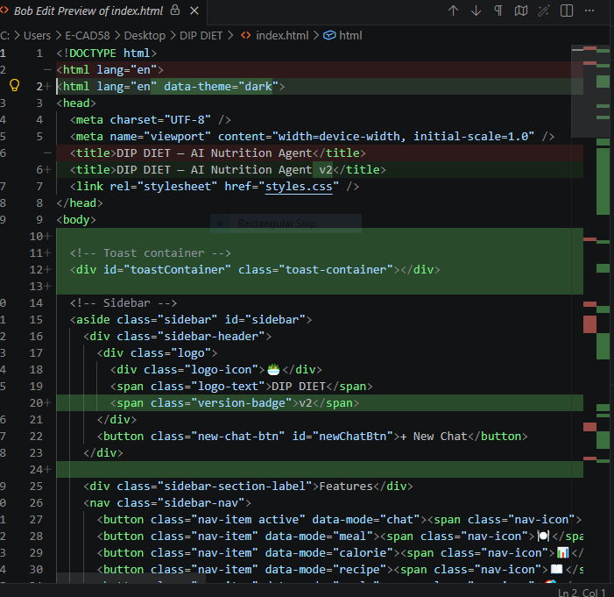
Required Files created using IBM bob -
App.py
Server.js
Server.py
Style.css
Index.html

Slide 7
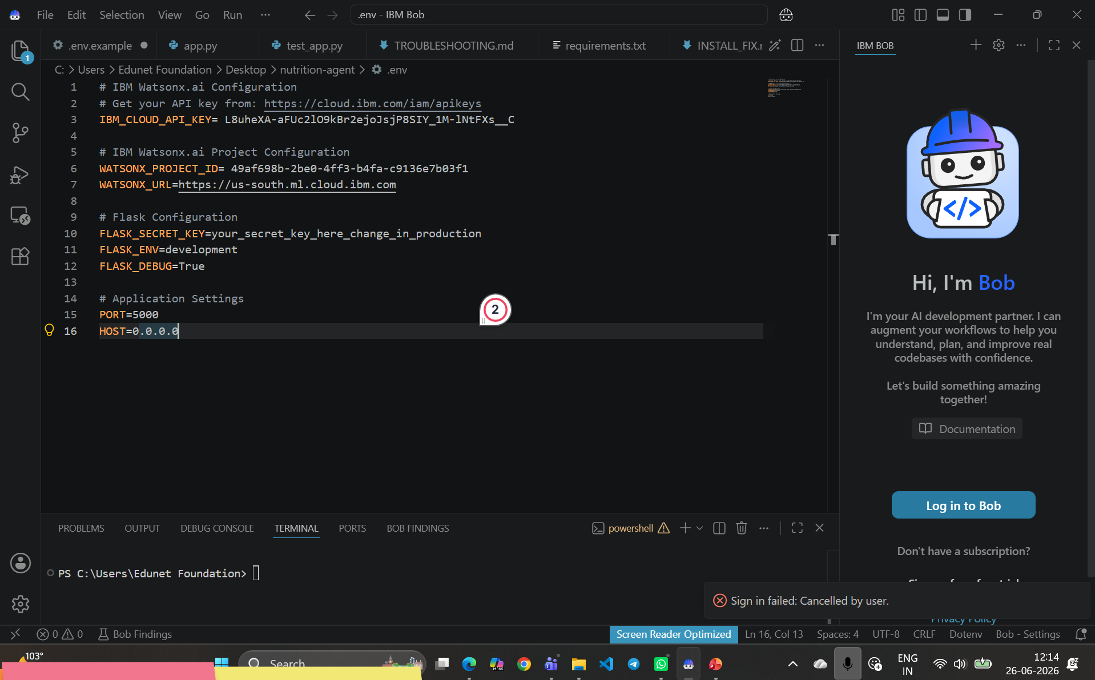
IBM Bob Screenshots:

Slide 8
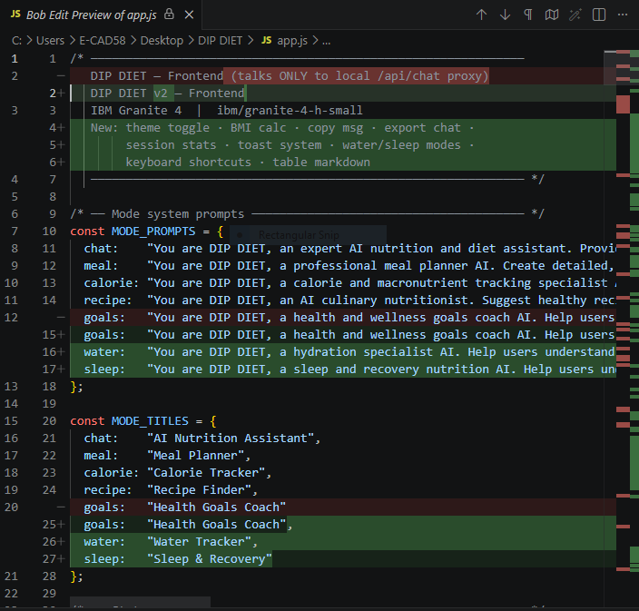

Slide 9
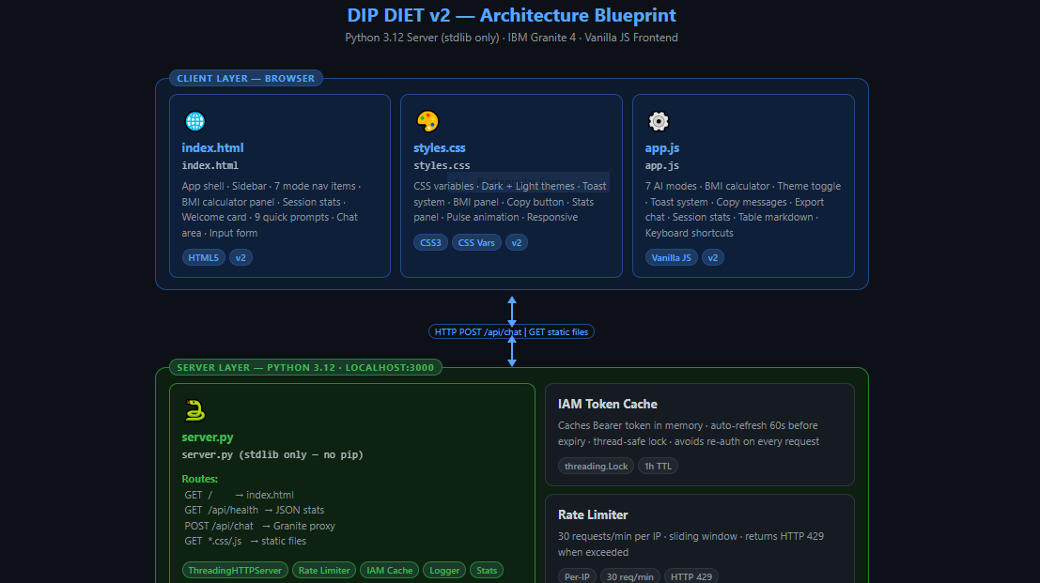
Architecture blueprint for IBM bob:

Slide 10

Role of Agentic AI in the solution
Role of Agentic AI in DIP DIET RAG PROJECT
Agentic AI enhances a Retrieval-Augmented Generation (RAG) diet project by acting as an intelligent assistant that can plan, retrieve, analyze, and provide personalized recommendations rather than only answering questions.
Roles of Agentic AI
Personalized Diet Planning
Collects user information such as age, weight, height, activity level, dietary preferences, allergies, and health conditions.
Generates customized meal plans based on individual nutritional needs.
Intelligent Information Retrieval (RAG)
Retrieves the latest nutrition guidelines, clinical recommendations, and trusted dietary information from a verified knowledge base.
Ensures responses are accurate, up-to-date, and evidence-based.
Health Monitoring
Tracks daily calorie intake, water consumption, exercise, and weight changes.
Continuously evaluates user progress and updates recommendations.
Adaptive Recommendations
Learns from user feedback and eating habits.
Suggests healthier food alternatives when users skip meals or consume unhealthy foods.
Risk Detection
Identifies unhealthy eating patterns, nutritional deficiencies, or excessive calorie intake.
Alerts users and recommends corrective actions or consultation with healthcare professionals when appropriate.
Benefits of Using Agentic AI
Delivers highly personalized diet recommendations.
Provides accurate responses using RAG-based knowledge retrieval.
Automates meal planning and progress tracking.
Encourages healthier habits through proactive reminders.
Improves user engagement and adherence to diet plans.
Supports long-term health management with adaptive, data-driven recommendations.

Slide 11
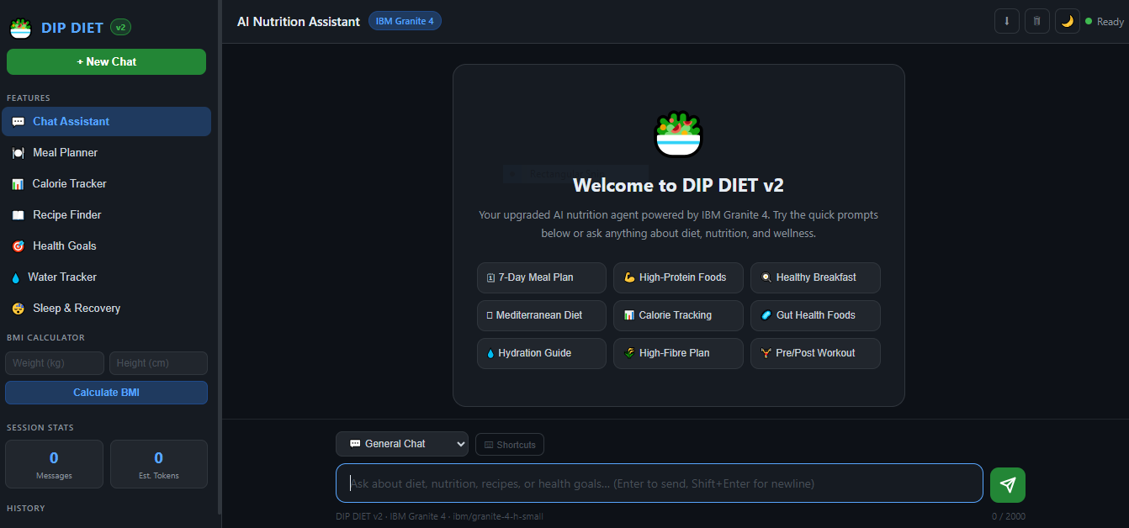
Project Output Screenshot
·
·
·

Slide 12
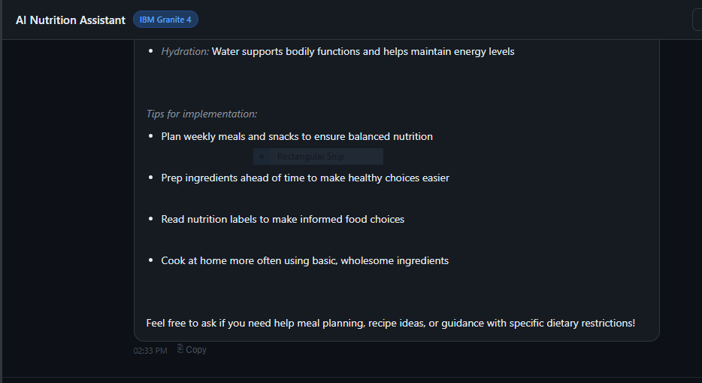
Project Output Screenshot
·
·
·

Slide 13
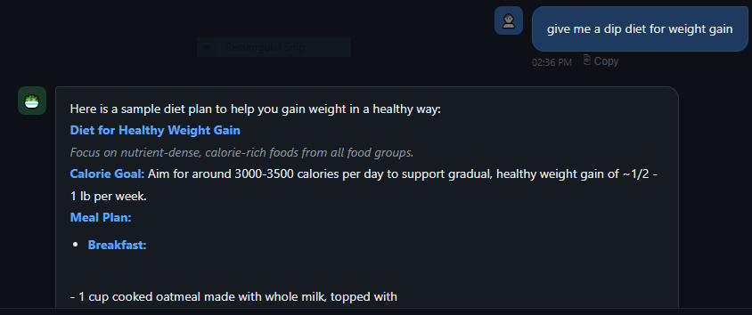
Project Output Screenshot
·
·
·

Slide 14
Novelty and Uniqueness
The proposed Nutrition Agent stands out by combining Agentic AI, RAG, and personalization into a single intelligent system.
Multi-Agent Intelligence – Instead of a single chatbot, multiple specialized agents collaborate to deliver accurate and context-aware nutrition guidance.
RAG-Based Accuracy – Integrates real-time data retrieval with AI generation, reducing misinformation and ensuring trustworthy recommendations.
Hyper-Personalization – Tailors diet plans based on health conditions, cultural preferences, and fitness goals.
Real-Time Feedback Loop – Continuously adapts recommendations based on daily food logs and user behavior.
Multi-Modal Input – Supports text, voice, and image-based meal tracking for better usability.
Preventive Healthcare Focus – Goes beyond diet planning to provide disease-specific nutrition advice.
Scalable & Enterprise-Ready – Built on IBM watsonx.ai with IBM Granite models, ensuring reliability and governance.
This makes the solution a smart, adaptive, and proactive digital nutritionist, not just a static diet recommendation tool.

Slide 15
Git Hub Link
· Please create public github repository (Enable Add README button while creating repository) with format –
Please test and Paste the working Github URL –
Make sure you have Uploaded following three files into your github repository 1) All Agent relevant files of IBM Cloud , 2) yourproblemstatement.pdf file 3) your projectpresntation.pptx file 4)any other files
·
·
·

Slide 16
Future Scope
Connect with smartwatches and fitness bands to monitor heart rate, physical activity, sleep, and calories burned in real time.
Real-Time Health Monitoring
Integrate with digital health records and medical reports to provide more personalized and clinically relevant dietary recommendations.
Advanced Personalization
Use AI to continuously learn users' eating habits, preferences, allergies, and health goals to deliver increasingly accurate meal plans.
Multilingual Support
Support multiple regional and international languages, making the system accessible to a broader population.
Voice-Based AI Assistant
Integration with Wearable Devices
Enable users to interact with the system through voice commands for meal planning, nutrition advice, and reminders.
Disease-Specific Nutrition Guidance
Expand support for conditions such as diabetes, hypertension, obesity, kidney disease, and heart disease with specialized diet recommendations.
Restaurant and Grocery Integration
Recommend healthy menu options at restaurants and generate grocery shopping lists based on personalized meal plans.
Predictive Health Analytics
Use machine learning to identify potential nutritional deficiencies and health risks before they become serious, enabling preventive care.
Telemedicine Integration
Allow dietitians and healthcare professionals to review AI-generated diet plans and provide expert consultation through the platform.
Continuous Knowledge Updates
Enhance the RAG system with the latest nutrition research, dietary guidelines, and clinical recommendations to ensure accurate and up-to-date advice.
·
·
·

Slide 17
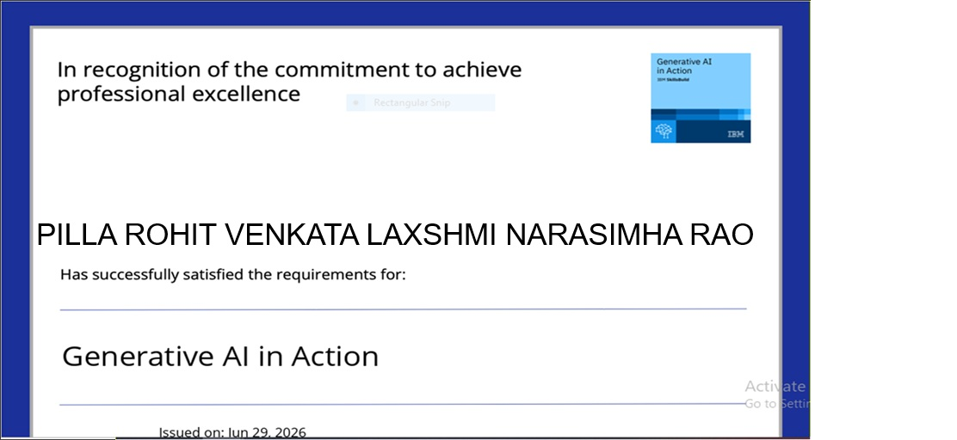
Certificates Earned:
Please add your credly certificate

Slide 18
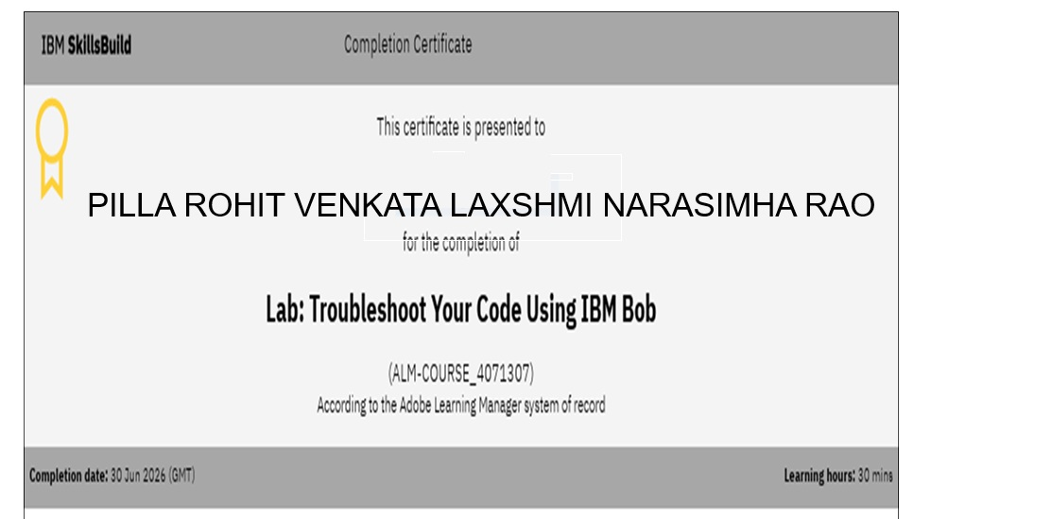
Certificates Earned:​
Add your IBM BOB Certificate

Slide 19


